Slide 1


APPLICATIONS OF MATHEMATICS
DEPARTMENT OF ARTIFICIAL INTELLIGENCE
GUIDED BY:
MR. GOVINDHARAJ.G
AP/AI
B.AARTHI 927621BAD002 S.R.GURUMEETA 927621BAD012
R.SUBAA G.SUPRIYA
927621BAD052
927621BAD055

Slide 2
Unlocking the Secrets of Discrete Mathematics in Cryptography
PRESENTED BY: SUBAA.R

Slide 3

Introduction to Discrete Mathematics in Cryptography
Discrete mathematics is the study of mathematical structures that are fundamentally discrete rather than continuous. It is used in cryptography to create secure communication channels between two parties.
Cryptography is the practice of protecting sensitive information by encoding it in such a way that only the intended recipient can decode it. Discrete mathematics is used to develop the algorithms that are used to encrypt and decrypt the data.

Slide 4

Data Encryption Algorithms
Data encryption algorithms are used to encrypt data so that it can be securely transmitted from one party to another. These algorithms use discrete mathematics to create complex mathematical equations that are used to scramble the data.
These algorithms are designed to be difficult to break, and they are used to ensure that only the intended recipient can decrypt the data. This ensures that the data is kept secure and private.

Slide 5
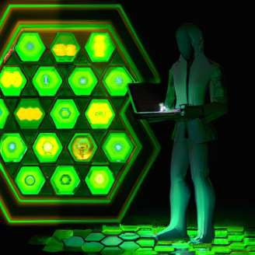
Cryptographic Hash Functions
Cryptographic hash functions are used to create a unique fingerprint of any given data. These functions use discrete mathematics to create complex mathematical equations that are used to generate a unique fingerprint for the data.
These fingerprints can be used to verify the integrity of the data, as any changes to the data will result in a different fingerprint. This ensures that the data has not been tampered with, and is as secure as possible.

Slide 6

Conclusion
Discrete mathematics is an essential part of cryptography, and it is used to create secure communication channels between two parties. Discrete mathematics is used to create complex mathematical equations that are used to encrypt and decrypt data, generate unique fingerprints, generate keys, and generate digital signatures.
These algorithms and techniques ensure that data is kept secure, and that it can be trusted. Discrete mathematics is an essential part of cryptography, and it is used to ensure that data is kept secure and private.

Slide 7
Unlocking the Power of Math in Medicine
PRESENTED BY: S.R.GURUMEETA

Slide 8
Mathematics in Healthcare
Mathematics is an integral part of healthcare, from calculating dosages to predicting outcomes. Mathematical models are used to understand the dynamics of disease, assess the effectiveness of treatments, and even design medical devices. With the advancement of technology, mathematics can now be used to analyze large amounts of patient data and provide insights into the best possible treatments for individual patients.

Slide 9
Medical Imaging
Mathematics is also used in medical imaging, which allows healthcare professionals to visualize the inside of the body. By using mathematical models to analyze the images, healthcare professionals can identify abnormalities and diagnose diseases. Mathematics can also be used to develop new imaging techniques, such as 3D imaging and nuclear imaging.

Slide 10
Medical Robotics
Mathematics is also used in medical robotics, which allows healthcare professionals to perform complex medical procedures with greater precision and accuracy. By using mathematical models to analyze the images, healthcare professionals can identify abnormalities and diagnose diseases. Mathematics can also be used to develop new medical devices, such as prostheses, implants, and surgical robots.

Slide 11
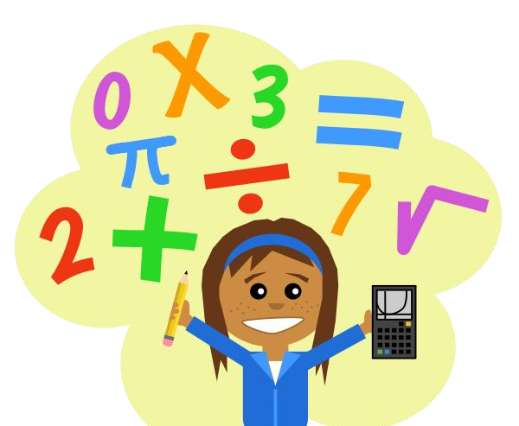
APPLICATIONS OF MATHEMATICS

Slide 12

MATHS IN MARKETING
Markets - dealing with money.
To earn money we need a lot
Of maths.
And a person doesn’t know Maths and going to loose his Money unnecessarily
…Because he doesn’t know the Calculation of money.

Slide 13
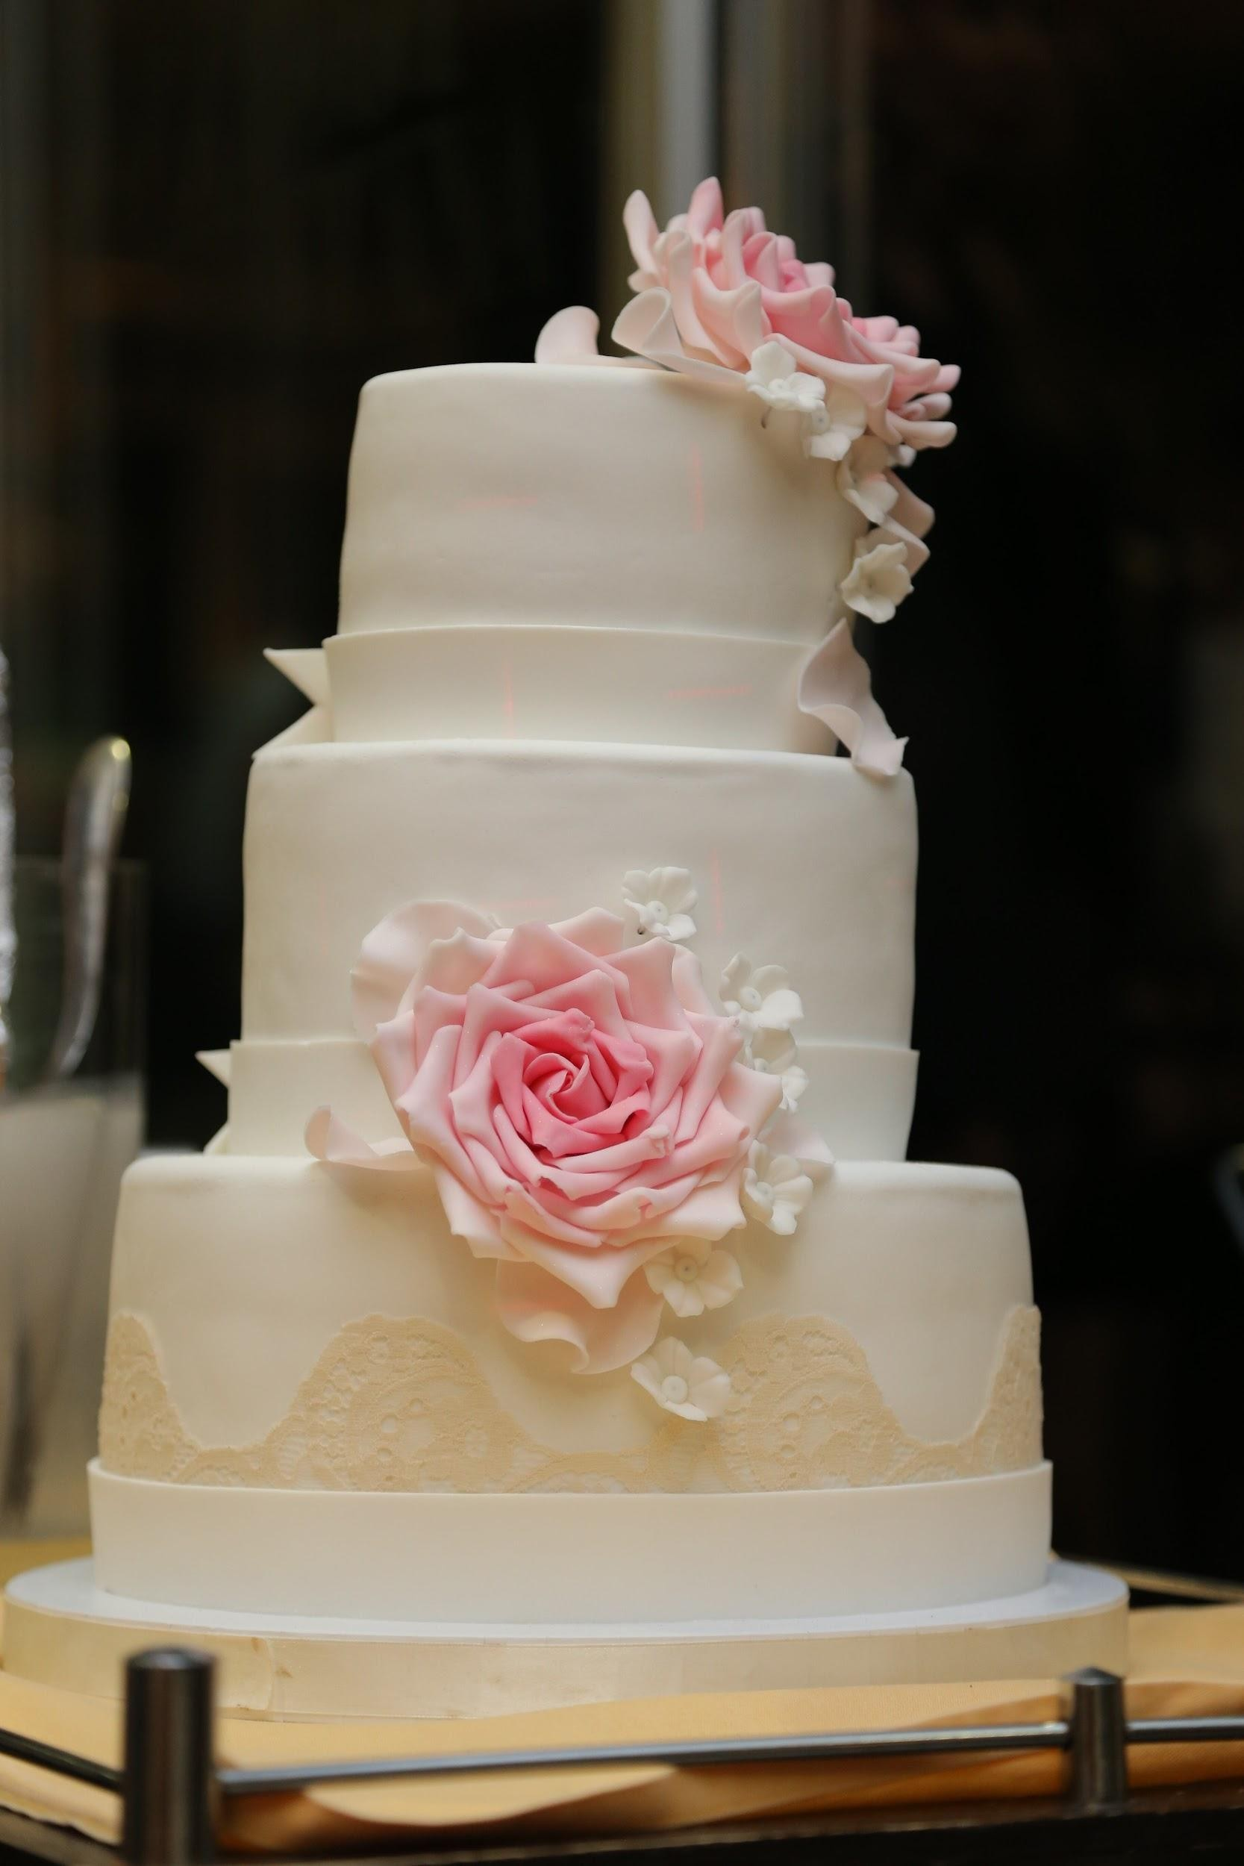
MATHEMATICS IN KITCHEN
In cooking, idea of proportionality
Is the most important factor For perfection.Without this we Cannot make exact quantity of Food that we want.
For example:- If we want to make
A cake of 1 kg but in recipe of 2 kg of cake. Then idea of proportionality is important.

Slide 14

MATHS IN SHOPPING
Going out for shopping is
The most important thing we do.
Sale and calculation both require maths.
Example - you need to calculate The rate of a material you are Buying in the sale…and if you went Wrong somewhere you need to do a False paying pf the bill.

Slide 15
MATHEMATICAL THEORY USED IN REAL TIME
PRESENTED BY:
B. AARTHI

Slide 16
Weather forecasting
The weather is an incredibly complex system with billions of molecules interacting. This makes predicting the weather a surprisingly difficult tasks even using the extensive network of weather stations satellites and the world’s largest supercomputers.
Fluids like the atmosphere follow a set of rules called the Navier Stokes equations. Unfortunately we don’t know a direct solution for these equations – one of the greatest unsolved problems in mathematics and one of the $1 million Millennium Prize Problems.
Instead, supercomputers divide the entire atmosphere into millions of blocks each around one cubic kilometer in size and use numeric simulations to create a high-resolution forecast.
But even tiny differences in measurements and the simulation parameters can have great effect on these predictions. Therefore, it is still impossible to accurately predict the weather more than a few weeks in advance – but the accuracy of mathematical models and speed of computers will only improve in the future…
◦
◦

Slide 17
GAMBLING
While it is impossible to use probability to predict the next dice roll or roulette number you can accurately predict what might happen in the next 1000 dice rolls – this is called the Law of Large Numbers. Even a winning probability of 49% gives the “house” a sufficient “edge” to make great profits.
You can also use game theory random walks and statistics to develop and test gambling
strategies. Sports betting is particularly interesting because the odds change over time.

Slide 18
SEARCH ENGINES
Billions of people use the internet every day. One of the reasons is that the internet makes it so
easy to find information quickly for example using search engines like Google.
In order to find the most useful websites and display them at the top Google represents all pages on the internet in a gigantic matrix. The matrix knows about how the various websites are linked and you can use linear algebra probability and graph theory to find the most popular sites.
◦

Slide 19
FINANCE AND BANKING
Financial analysts have many different mathematical tools to help them make better decisions for example statistical models to analyse historic economic data or probability and Stochastic calculus to predict the behaviour of financial markets. Particularly famous is the Black-Scholes equation a partial differential eqaution used to find the correct value of derivatives.

Slide 20


